Slide 1
CSE1201: Object Oriented Programming-I (C++)
Lecture 17

Slide 2
Outline
Introduction to Standard Template Library
Namespace

Slide 3
Standard Template Library(STL)
STL is one of the most important feature added to C++
It provides general-purpose, templatized classes and functions that implement many popular and commonly used algorithms and data structures. It also defines various routines that access them.
Because the STL is constructed from template classes, the algorithms and data structures can be applied to nearly any type of data.

Slide 4
Standard Template Library(STL)
At the core of the standard template library are three foundational items:
Containers,
Algorithms, and
Iterators.

Slide 5
Containers
Containers are objects that hold other objects, and there are several different types.
They have the ability to store objects of any type (template)
Containers form the basis for treatment of data structures
STL consists of more than 10 container classes:
Sequence containers
Adapter containers
Associative containers

Slide 6
Containers
Sequence Container
Stores data by position in linear order:
First element, second element , etc:
Associate Container
Stores elements by key, such as name, social security number or part number
Access an element by its key which may bear no relationship to the location of the element in the container
Adapter Container
Contains another container as its underlying storage structure

Slide 7
Containers
Sequence Container
Vector
Deque
List
Adapter Containers
Stack
Queue
Priority queue
Associative Container
Set, multiset
Map, multimap

Slide 8
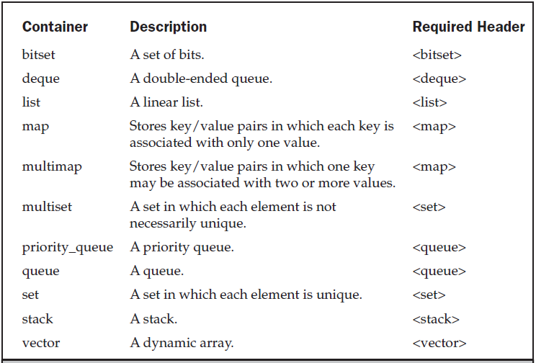
Containers

Slide 9
Vector
Provides an alternative to the built in array.
A vector is self grown.
Syntax: vector<of what>
For example :
vector<int> - vector of integers.
vector<string> - vector of strings.
vector<int * > - vector of pointers to integers.
vector<Shape> - vector of Shape objects. [Shape is a user defined class]

Slide 10
Using Vector
Array Style
void simple_example()
{ const int N = 10; vector<int> ivec(N);
for(int i=0; i < 10; ++i)
cin >> ivec[i];
}
STL Style
void simple_example()
{ vector<int> ivec;
int input;
while ( cin >> input ) ivec.push_back(input);
}

Slide 11
Algorithms
Algorithms act on containers.
They provide the means by which you will manipulate the contents of containers.
Their capabilities include initialization, sorting, searching, and transforming the contents of containers.
Many algorithms operate on a range of elements within a container.
find
merge
reverse
sort
and more: count, random shuffle, remove, Nth-element, rotate.

Slide 12
Iterators
An iterator represents a certain position in a container.
Iterators are objects that act, more or less, like pointers.
They give you the ability to cycle through the contents of a container in much the same way that you would use a pointer to cycle through an array.
Operator *
Returns the element of the actual position.
Operator ++
Lets the iterator step forward to the next element.
Most iterators also allow stepping backwards by using operator - -

Slide 13
Iterators
Operator == and !=
Returns whether two iterators represent the same position.
Operator =
Assigns an iterator (the position of the element to which it refers)
begin( )
returns an interator that represents the beginning of the elements in the container.
end( )
returns an iterator that represents the end of the elements in the container.
The end position is behind the last element.

Slide 14
Operations on Vector
iterator begin();
iterator end();
bool empty();
void push_back(const T& x);
iterator erase(iterator it);
iterator erase(iterator first, iterator last);
void clear();
….

Slide 15
Example
Write a program that read integers from the user, sorts them, and print the result.

Slide 16
Example
#include <iostream> // I/O
#include <vector> // container
#include <algorithm> // sorting
int main() { int input; vector<int> ivec; while(cin >> input) ivec.push_back(input);
sort(ivec.begin(),ivec.end());
vector<int>::iterator it; for ( it = ivec.begin(); it != ivec.end(); ++it) cout << *it << " "; cout << endl;
return 0;
}
Container (Vector declaration)
Input
Sort
Output

Slide 17
Namespace
A namespace is a declarative region.
It localizes the names of identifiers to avoid name collisions.
The C++ standard library is defined within its own namespace, called std
Therefore, we include the following line in the C++ programs:
using namespace std;

Slide 18
Namespace
#include <iostream>
using namespace std;
int main()
{
char str[16];
cout << “Enter a string: ”;
cin >> str;
cout << “You entered: ” << str;
}
#include <iostream>
int main()
{
char str[16];
std::cout << “Enter a string: ”;
std::cin >> str;
std::cout << “You entered: ” << str;
}

Slide 19
Reference
Chapter 33,34,35
[Object Oriented Programming with C++
- E Balagurusamy]

Slide 20
Thank you

